Slide 1
DATA ANALYST
Portofolio
Sedikit pengalaman yang berkaitan dengan data analyst, saya melakukan penelitian/tugas akhir (skripsi) menggunakan python, dan juga sedikit project data visualization menggunakan Tableau Public
Github:
https://github.com/FedricoS E-mail: fedricosimatupang34@gmail.com Linkedin:
www.linkedin.com/in/fedricos
IG :
https://www.instagram.com/ricos_18/
CV
Fedrico Simatupang

Slide 2
CONTENTS OF THIS TEMPLATE
Here’s what you’ll find in this Slidesgo template:
A slide structure based on a CV presentation, which you can easily adapt to your needs. For more info on how to edit the template, please visit Slidesgo School or read our FAQs.
To view this template with the correct fonts in ppt format, download and install on your computer the fonts that we have used. You can learn how to download and install fonts here.
An assortment of graphic resources that are suitable for use in the presentation can be found in the alternative resources slide.
A thanks slide, which you must keep so that proper credits for our design are given.
A resources slide, where you’ll find links to all the elements used in the template.
Instructions for use.
Final slides with:
The fonts and colors used in the template.
A selection of illustrations. You can also customize and animate them as you wish with the online editor. Visit Storyset to find more.
More infographic resources, whose size and color can be edited.
Sets of customizable icons of the following themes: general, business, avatar, creative process, education, help & support, medical, nature, performing arts, SEO & marketing, and teamwork.
You can delete this slide when you’re done editing the presentation.

Slide 3
Contoh pertanyaan bisnis
Business Question
Berapa jumlah transaksi di e-commerce kita perbulan?
Berapa total income yang didapat perbulan?
Berapa total produk yang terjual di e-commerce kita perbulan?
Berapa jumlah transaksi berdasarkan tipe store?
Berapa total income berdasarkan tipe store?
Berapa total produk yang terjual berdasarkan tipe store?
Bagaimana distribusi customer kita berdasarkan kota?
Bagaimana distribusi customer kita berdasarkan gender?

Slide 4
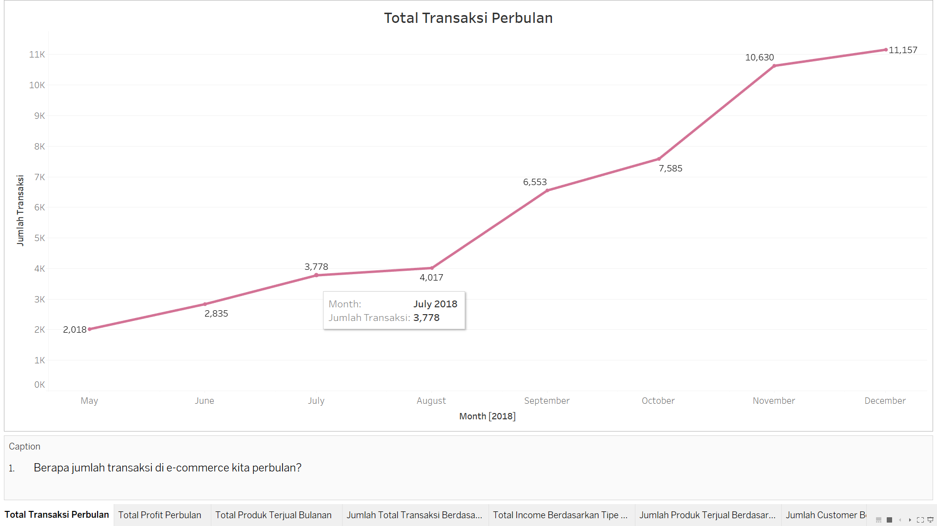
Berapa jumlah transaksi di e-commerce kita perbulan?

Slide 5
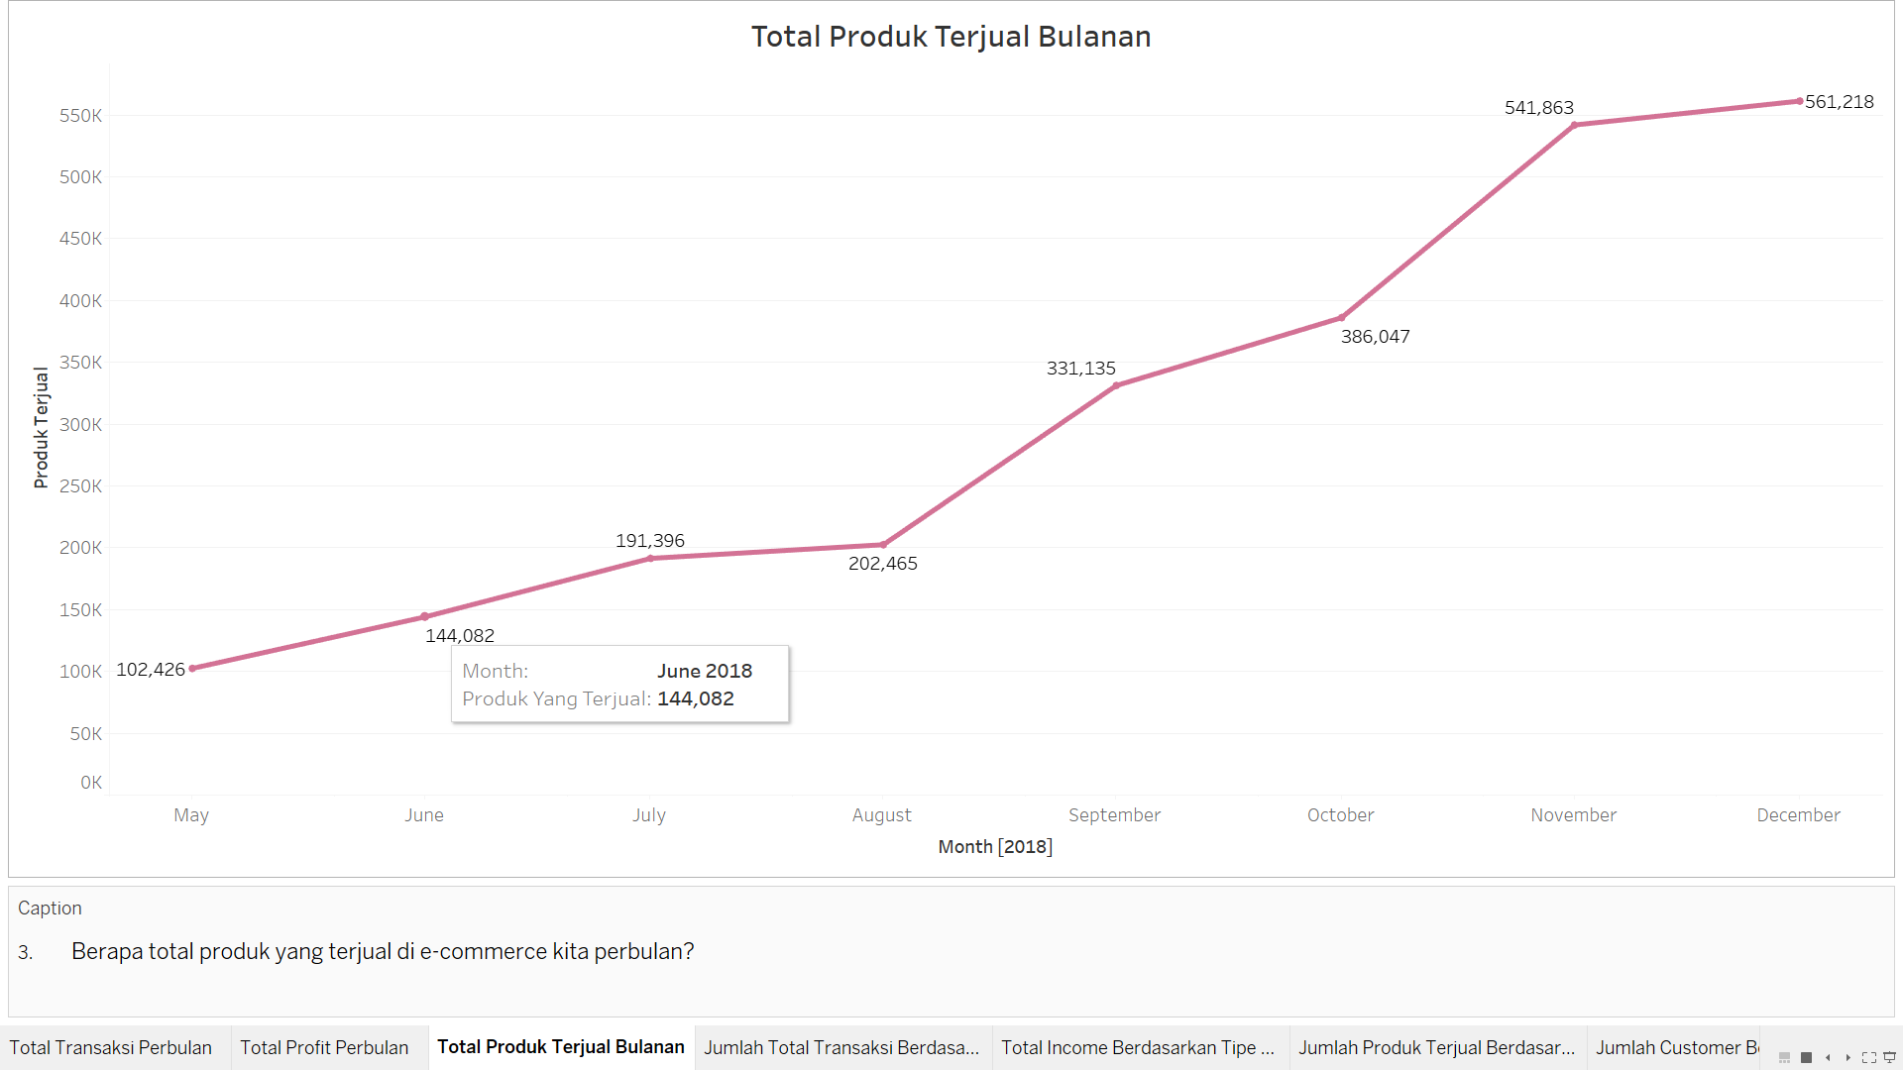
3. Berapa total produk yang terjual di e-commerce kita perbulan?

Slide 6
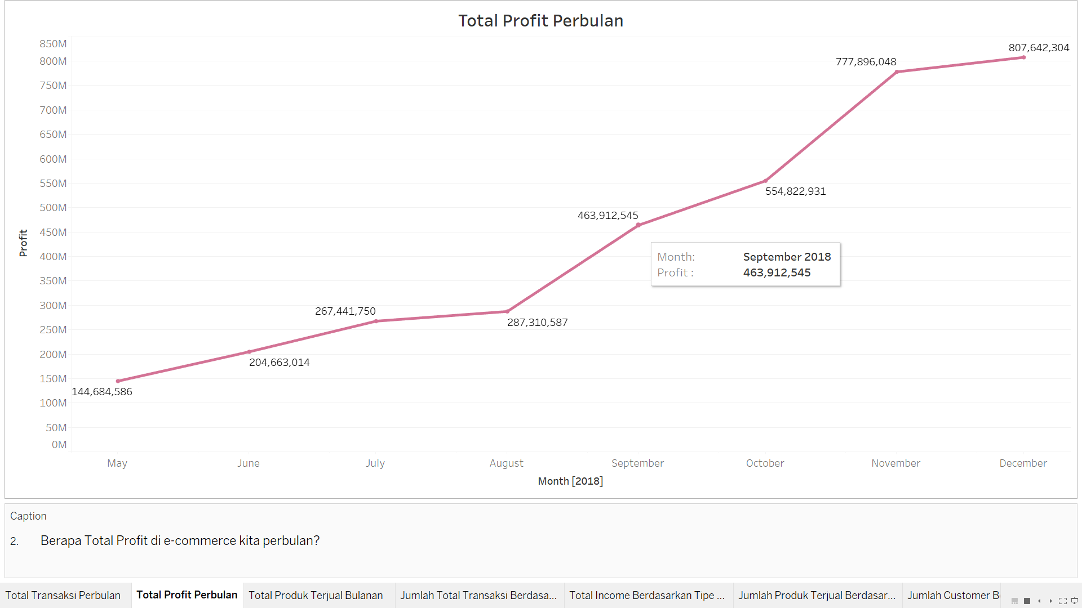
2. Berapa total income yang didapat perbulan?

Slide 7
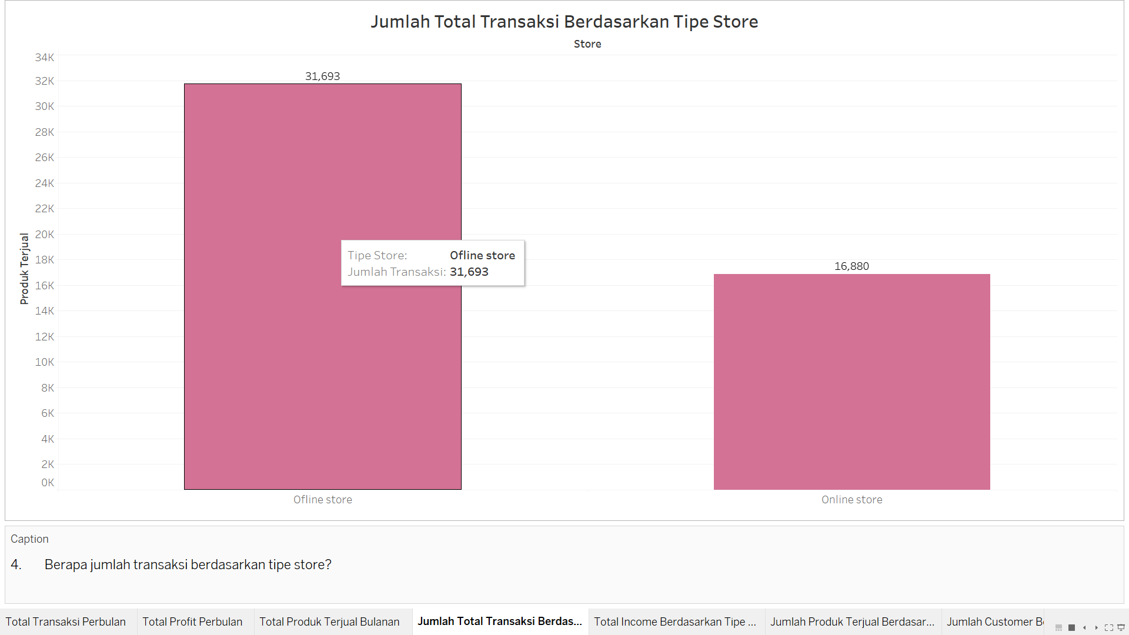
4. Berapa jumlah transaksi berdasarkan tipe store?

Slide 8
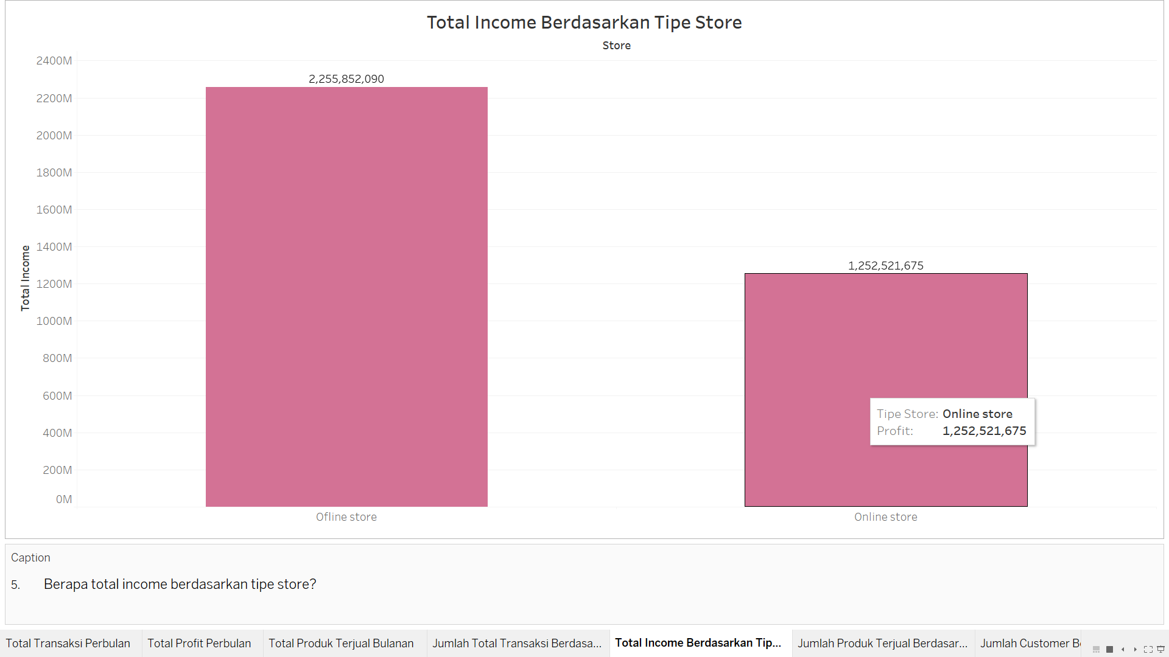
5. Berapa total income berdasarkan tipe store?

Slide 9
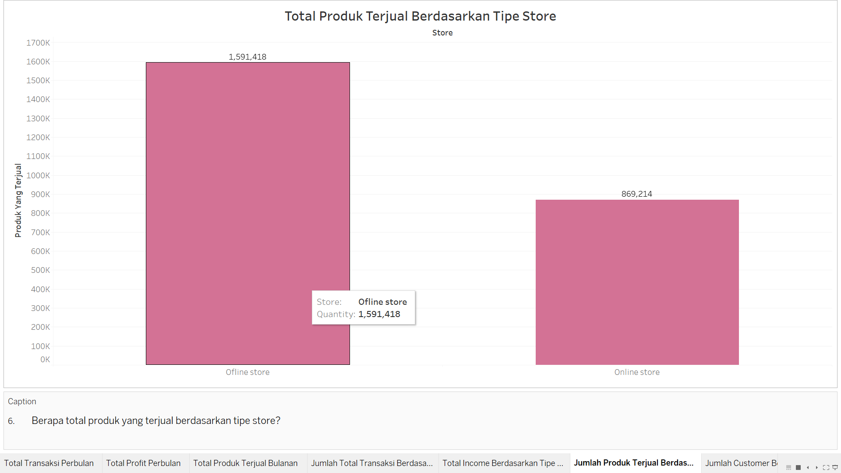
6. Berapa total produk yang terjual berdasarkan tipe store?

Slide 10
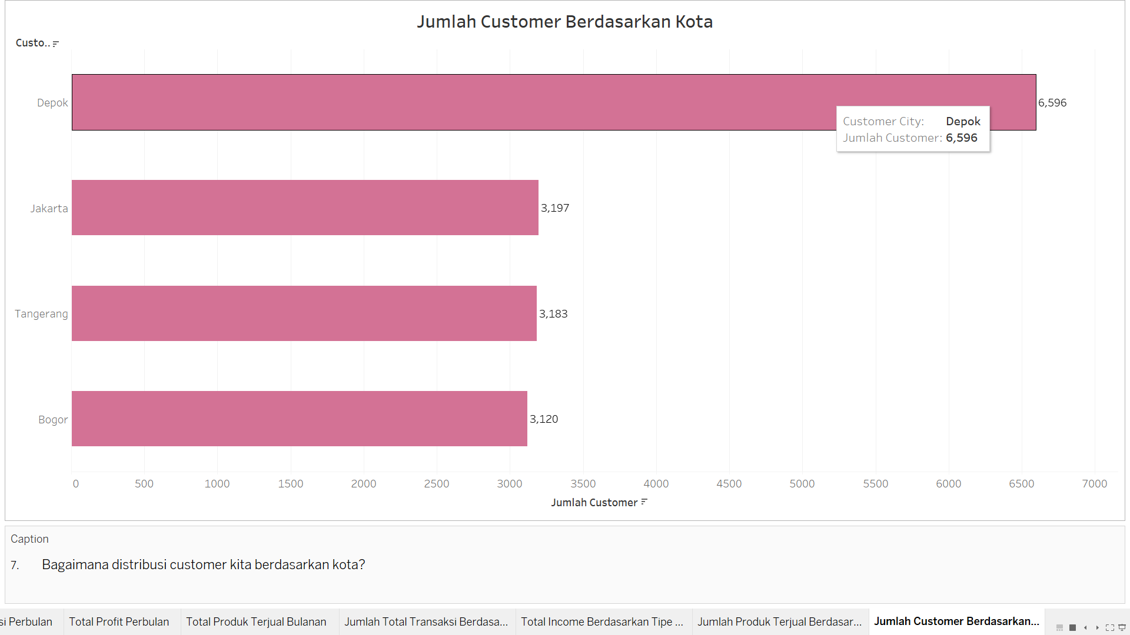
7. Bagaimana distribusi customer kita berdasarkan kota?

Slide 11
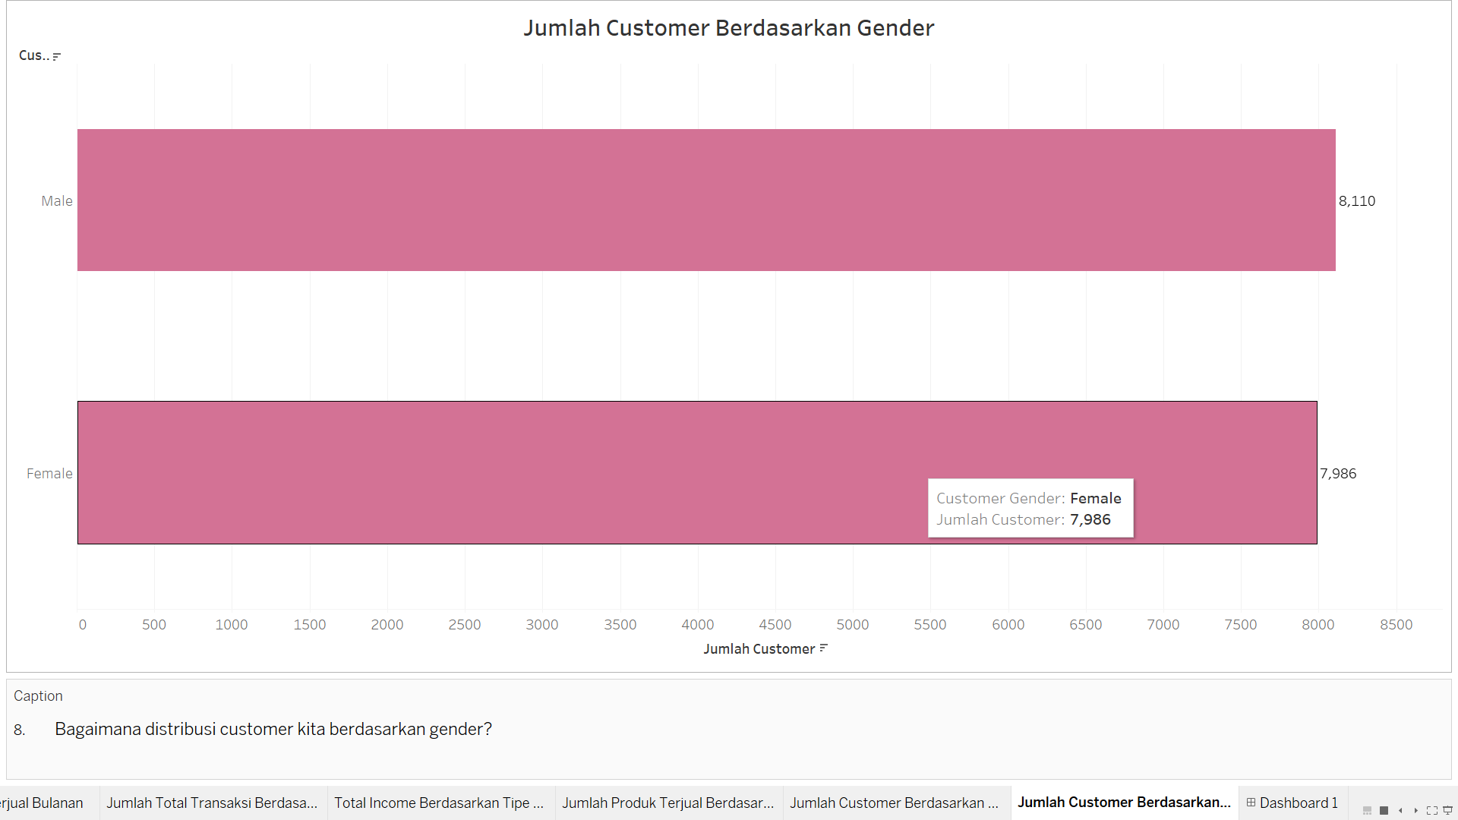
8. Bagaimana distribusi customer kita berdasarkan gender?

Slide 12
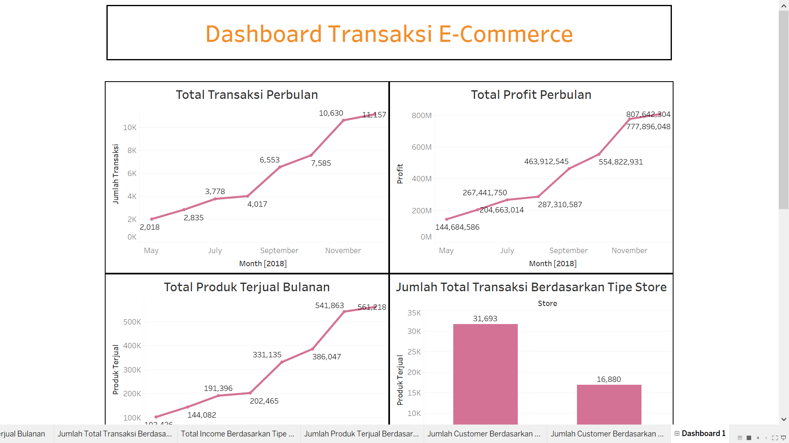
Dashboard Transaksi E-commerce

Slide 13
More Detailed:
https://public.tableau.com/views/DashboardTransaksiE-commerce_17067648260090/Dashboard1?:language=en-US&:display_count=n&:origin=viz_share_link

